Slide 1
Followup
Presentation
For TOUCH New York

Slide 2
Visual Mockups for Digital Recordkeeping System

Slide 3
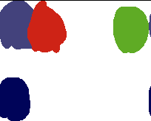
Visual Mockups: Typeface and Color Palettes
The UI design will match the design of the TOUCH website by using the same colors and fonts.
The three colors at the top are all picked from the TOUCH logo. The blue and red at the top should never be used to distinguish between two important items because their brightness is the same. The bottom two colors are picked from the TOUCH website.
Roboto is the font currently being used everywhere on the TOUCH website. It is a clean and simple font designed by Google that is in use on hundreds of popular services and apps.
Roboto

Slide 4
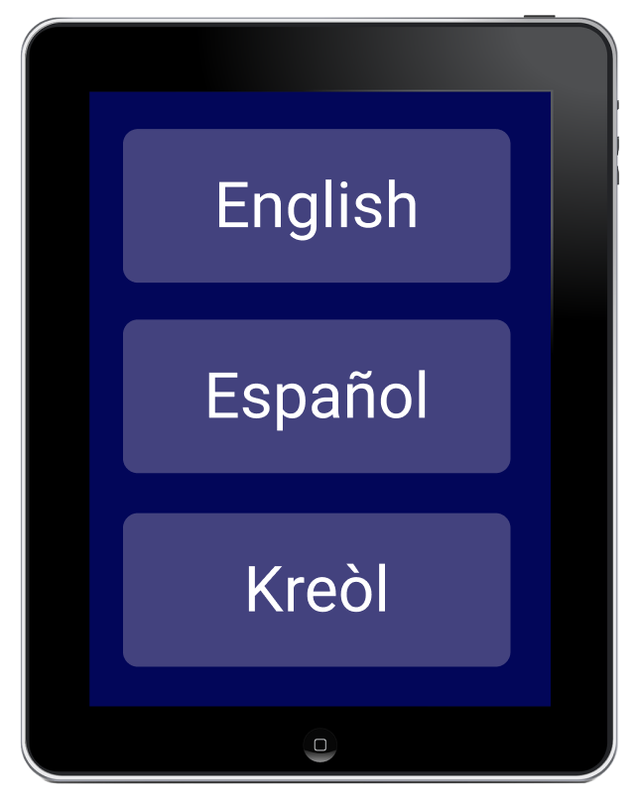
Visual Mockups: Form Language Select
The Client form can start with a screen that allows the user to pick their language.

Slide 5
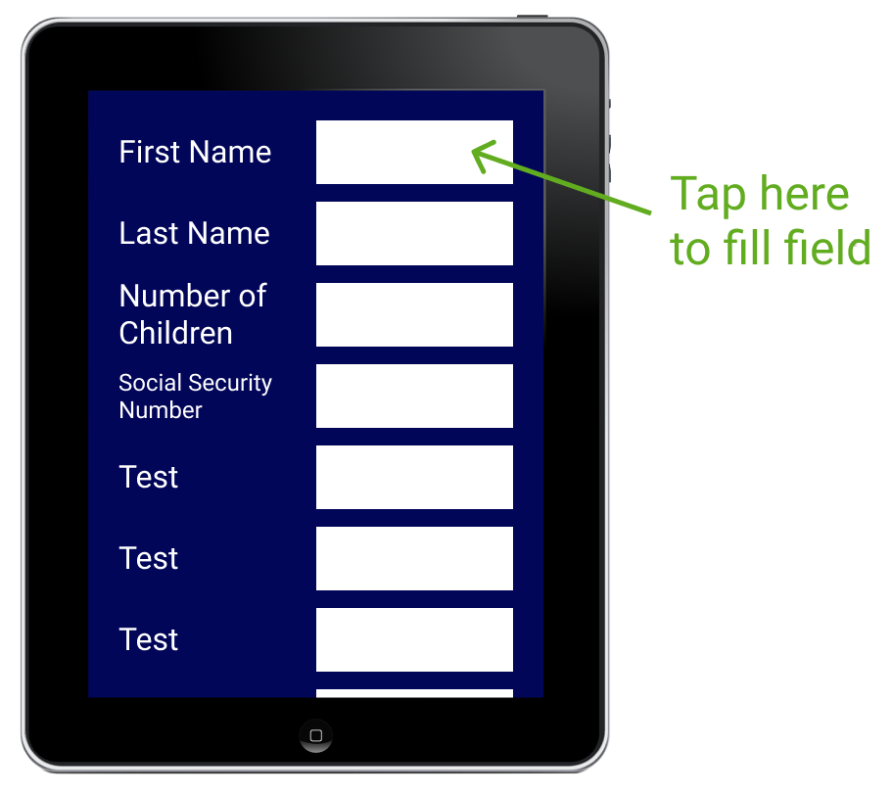
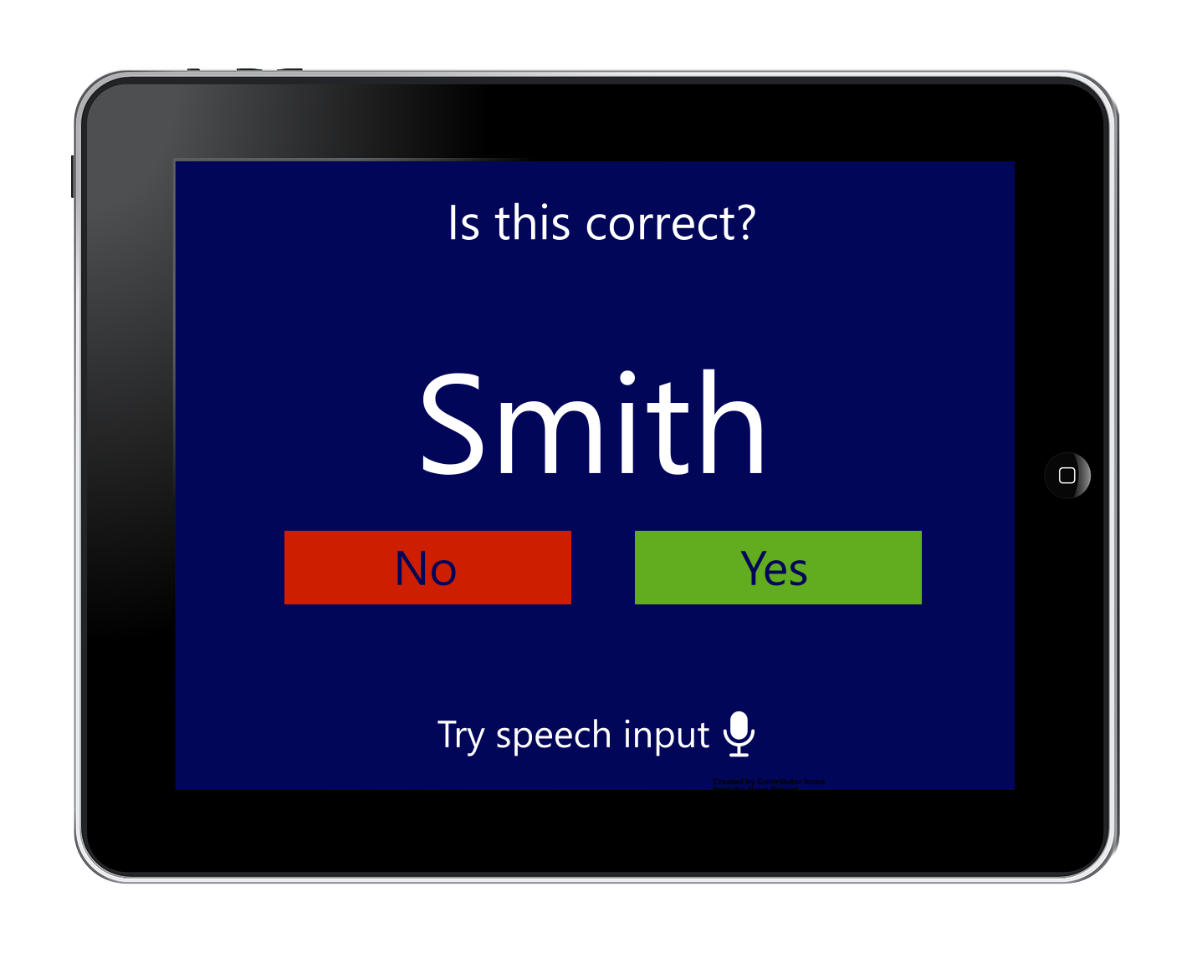
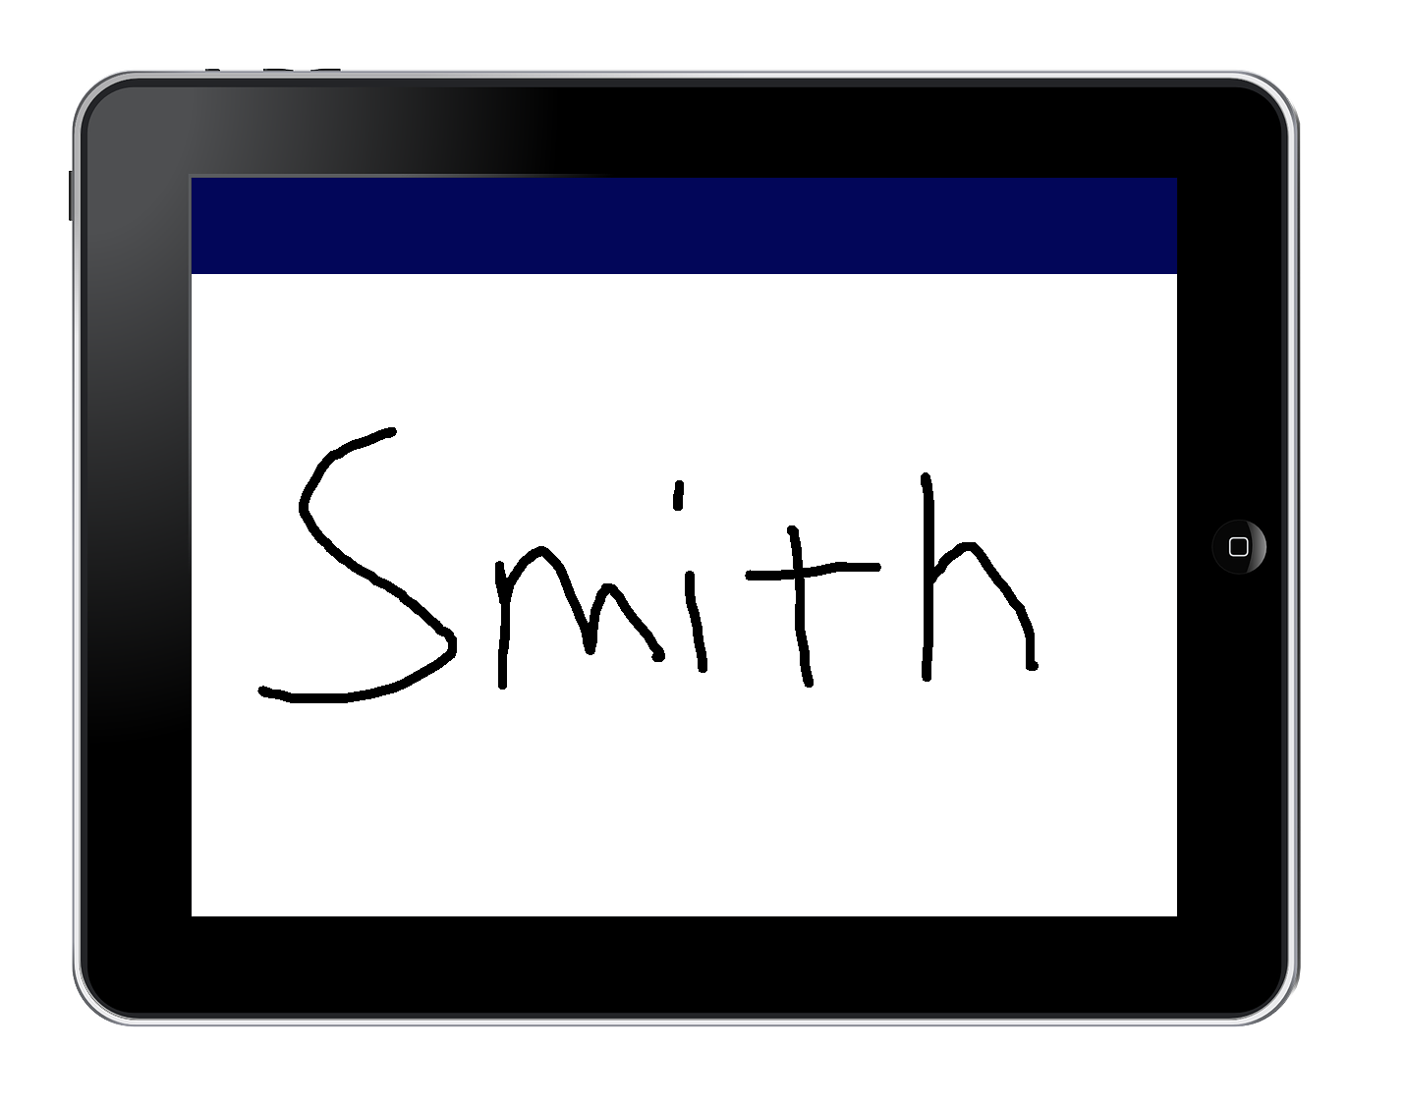
Visual Mockups: Form Interface
Please print your first name

Slide 6
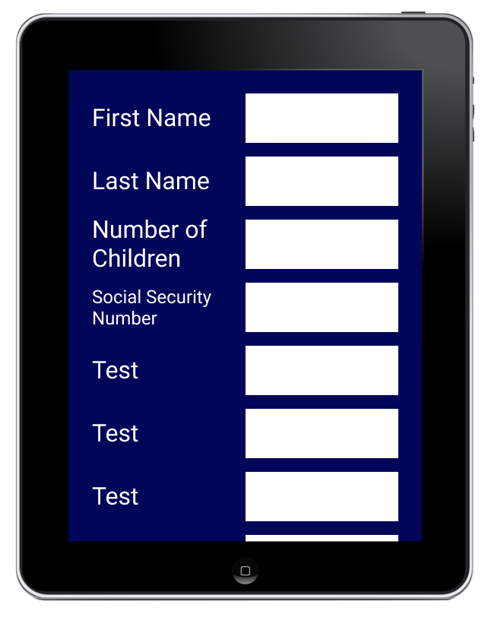
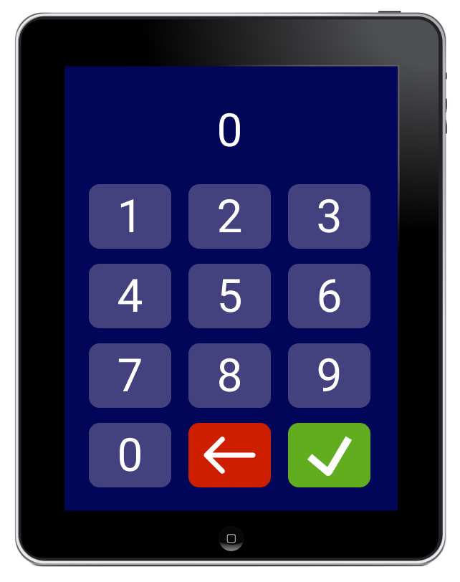
Visual Mockups: Form Number Entry

Slide 7
Other RCAH agencies Need Digital Record-Keeping More Than TOUCH
Last Friday afternoon, I had a phone call with Tiffany Lloyd from TOUCH.
It seems that TOUCH already has many digital forms of data entry and record-keeping in place. Lloyd stated that when she joined TOUCH, she replaced an old paper form with a Google Forms version.
She stated that any remaining paper forms might not be a good fit for converting to digital. Some forms, like TEFAP forms, are required by the government to be paper. Many of the volunteers are young disabled adults who might struggle to fill out a paper form (the digital tablet idea presented in previous slides may alleviate this). I believe she mentioned Palmer’s “volunteer portal” idea and stated that it may not be a good fit for the volunteers for the same reason (though she stated that the host of a volunteer group may be able to make use of the portal).

Slide 8
Other RCAH agencies Need Digital Record-Keeping More Than TOUCH (2)
In conclusion, what I learned from my call with Lloyd is it seems that TOUCH already has robust digital data entry and record keeping systems in place. This is also proved by their website, which has a Google Forms page for volunteer applications.
However, Lloyd told me that other smaller agencies in the Rockland Community Against Hunger network (which TOUCH is the leader of) may need a digital data entry and record-keeping overhaul more than TOUCH. For example, I could help by receiving the paper forms that these agencies use, and creating Google Forms pages.

Slide 9
Thank you!

